Slide 1

Chapter 32
Security in the Internet:
IPSec, SSL/TLS, PGP,
VPN, and Firewalls
Copyright © The McGraw-Hill Companies, Inc. Permission required for reproduction or display.

Slide 2
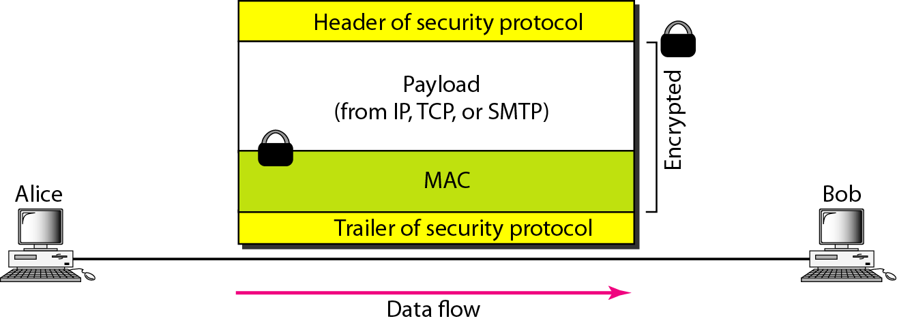
Figure 32.1 Common structure of three security protocols

Slide 3
32-1 IPSecurity (IPSec)
IPSecurity (IPSec) is a collection of protocols designed by the Internet Engineering Task Force (IETF) to provide security for a packet at the network level.
Topics discussed in this section:
Two Modes
Two Security Protocols
Security Association
Internet Key Exchange (IKE)
Virtual Private Network

Slide 4
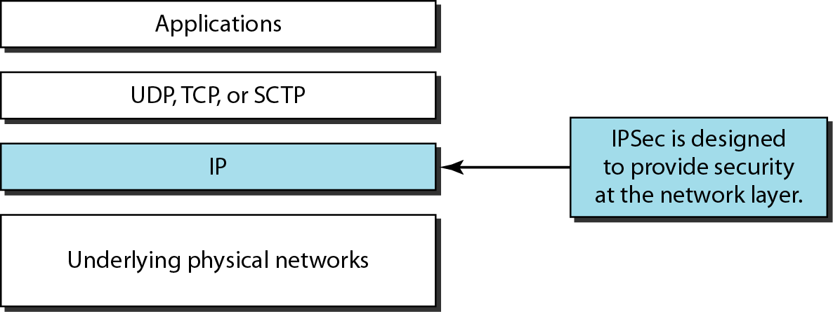
Figure 32.2 TCP/IP protocol suite and IPSec

Slide 5
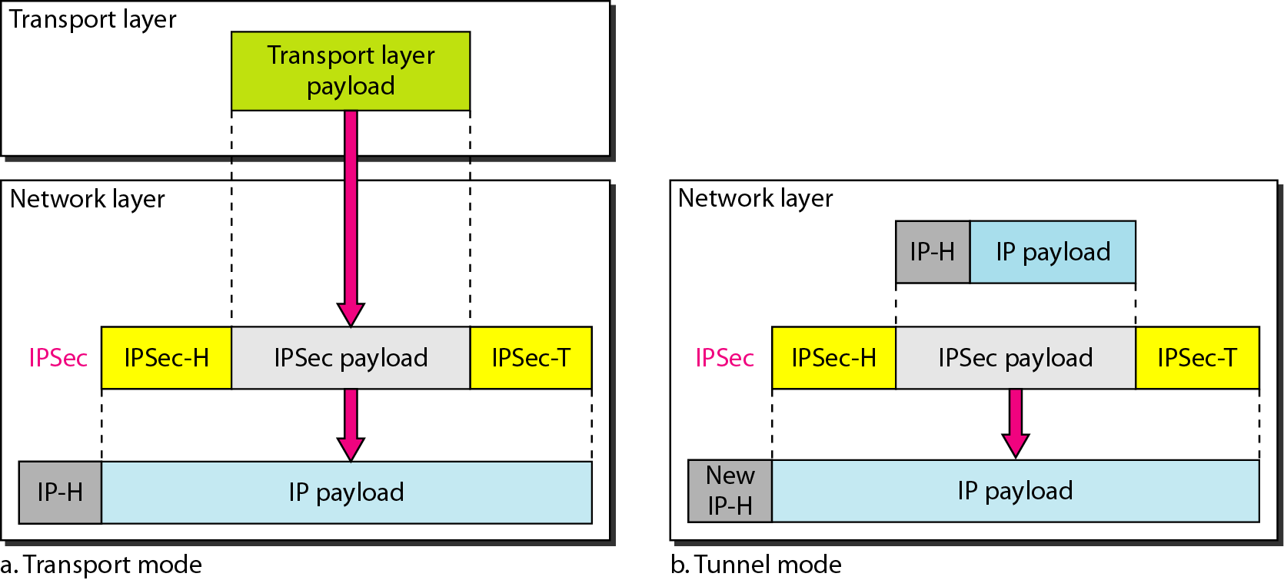
Figure 32.3 Transport mode and tunnel modes of IPSec protocol

Slide 6

Note
IPSec in the transport mode does not protect the IP header; it only protects the information coming from the transport layer.

Slide 7
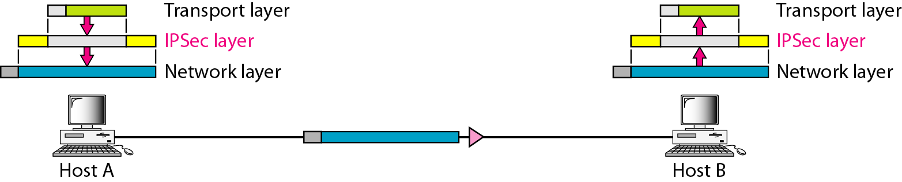
Figure 32.4 Transport mode in action

Slide 8
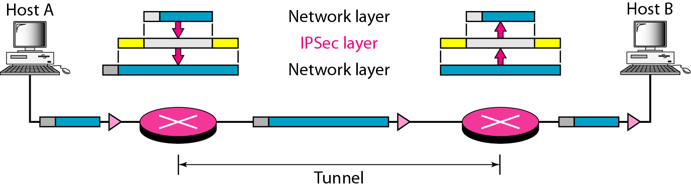
Figure 32.5 Tunnel mode in action

Slide 9
Note
IPSec in tunnel mode protects the original IP header.

Slide 10
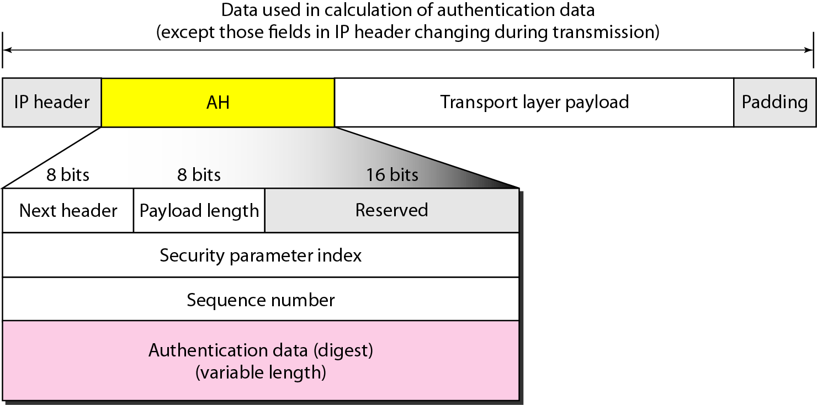
Figure 32.6 Authentication Header (AH) Protocol in transport mode

Slide 11
Note
The AH Protocol provides source authentication and data integrity,
but not privacy.

Slide 12
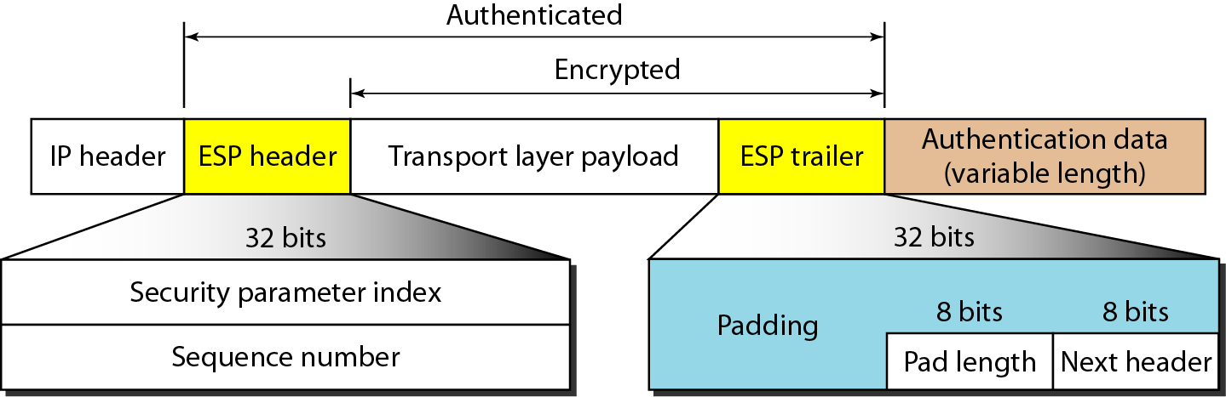
Figure 32.7 Encapsulating Security Payload (ESP) Protocol in transport mode

Slide 13
Note
ESP provides source authentication, data integrity, and privacy.

Slide 14
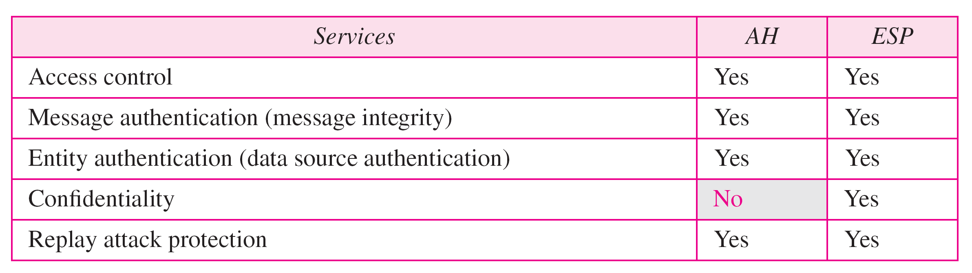
Table 32.1 IPSec services

Slide 15
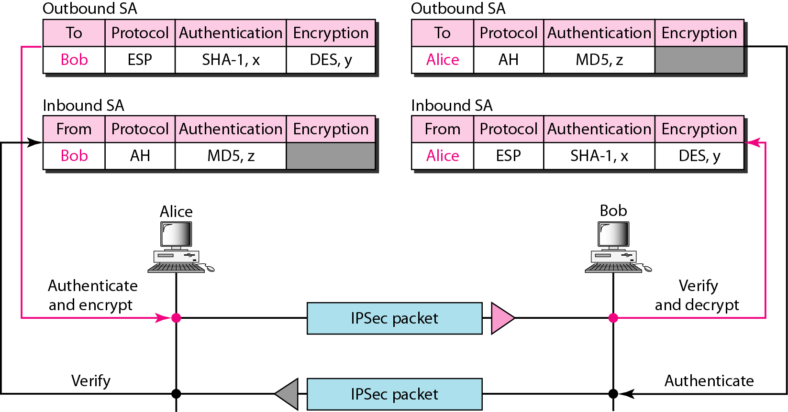
Figure 32.8 Simple inbound and outbound security associations

Slide 16
Note
IKE creates SAs for IPSec.

Slide 17
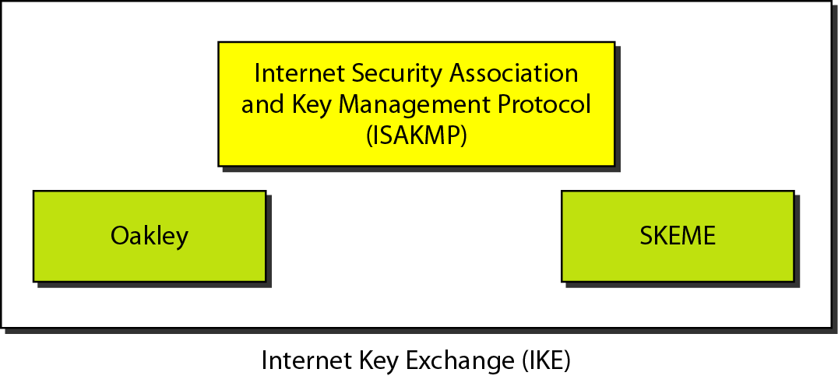
Figure 32.9 IKE components

Slide 18
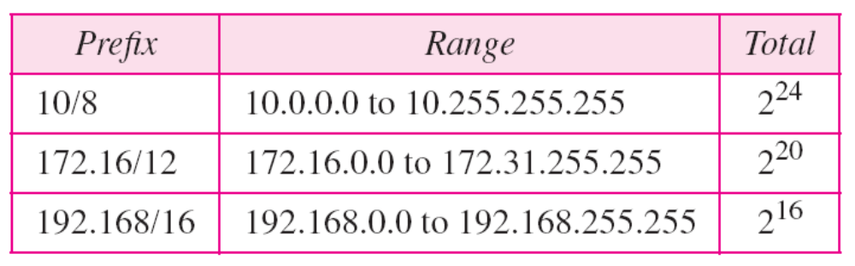
Table 32.2 Addresses for private networks

Slide 19
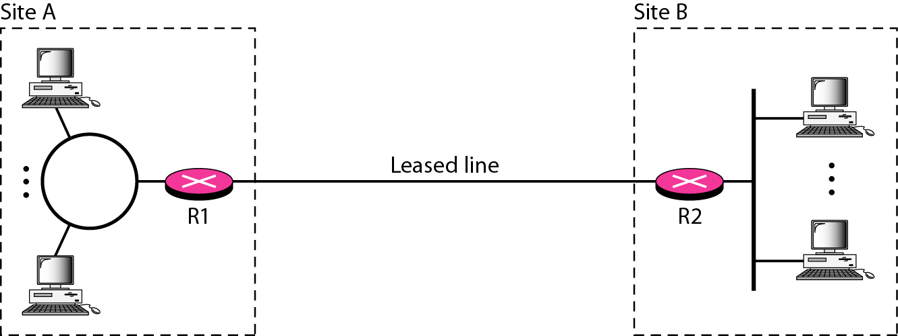
Figure 32.10 Private network

Slide 20
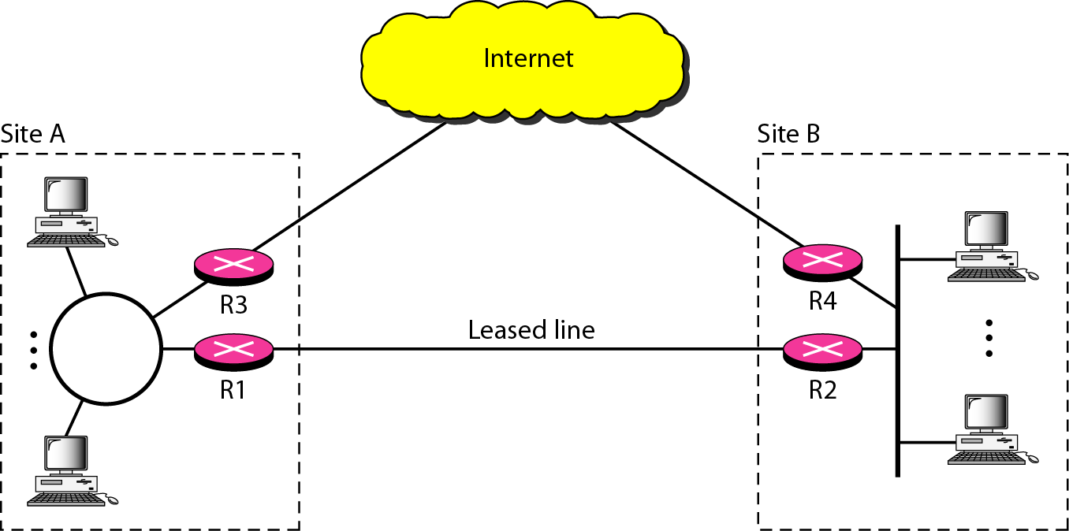
Figure 32.11 Hybrid network

Slide 21
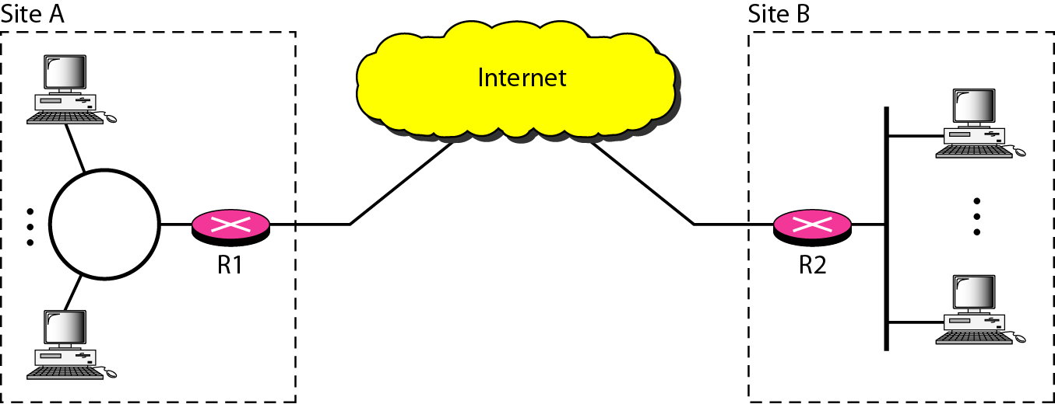
Figure 32.12 Virtual private network

Slide 22
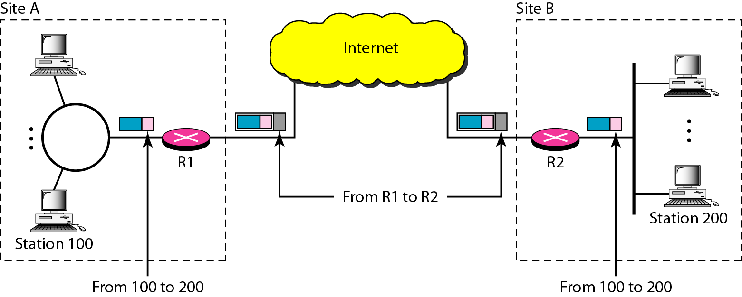
Figure 32.13 Addressing in a VPN

Slide 23
32-2 SSL/TLS
Two protocols are dominant today for providing security at the transport layer: the Secure Sockets Layer (SSL) Protocol and the Transport Layer Security (TLS) Protocol. The latter is actually an IETF version of the former.
Topics discussed in this section:
SSL Services
Security Parameters
Sessions and Connections
Four Protocols
Transport Layer Security

Slide 24
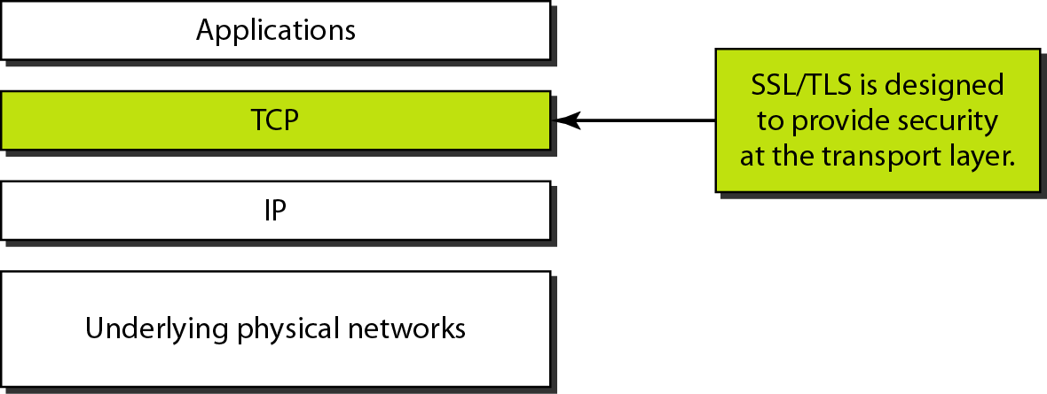
Figure 32.14 Location of SSL and TLS in the Internet model

Slide 25
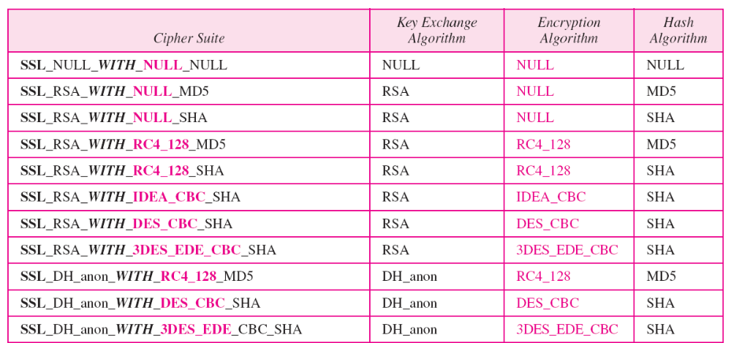
Table 32.3 SSL cipher suite list

Slide 26
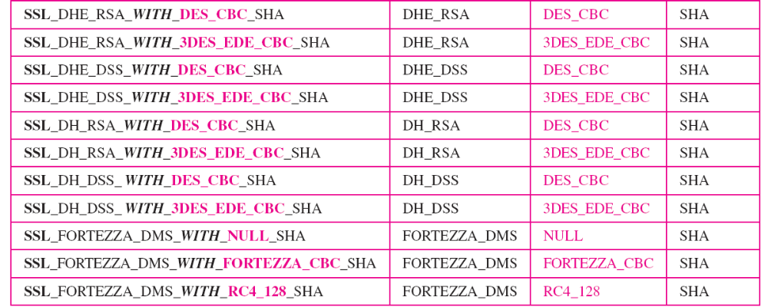
Table 32.3 SSL cipher suite list (continued)

Slide 27
Note
The client and the server have six different cryptography secrets.

Slide 28
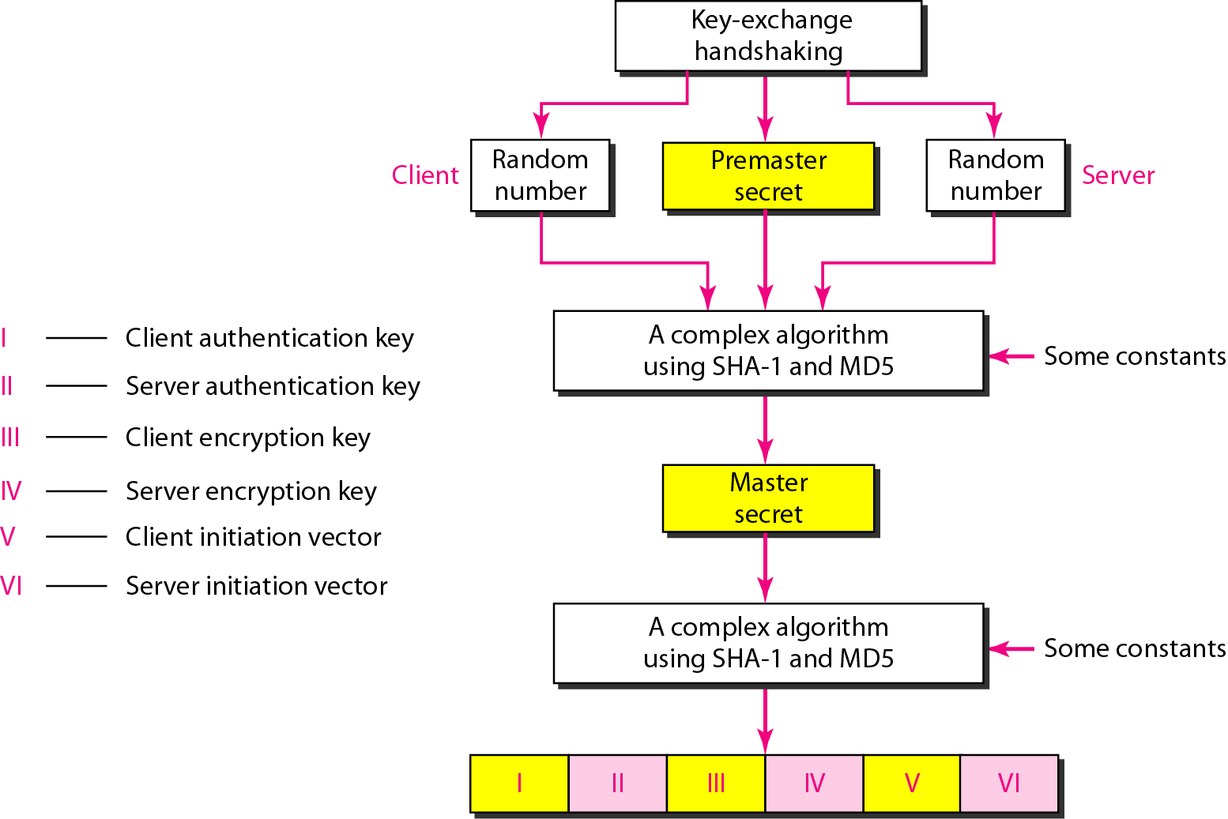
Figure 32.15 Creation of cryptographic secrets in SSL

Slide 29
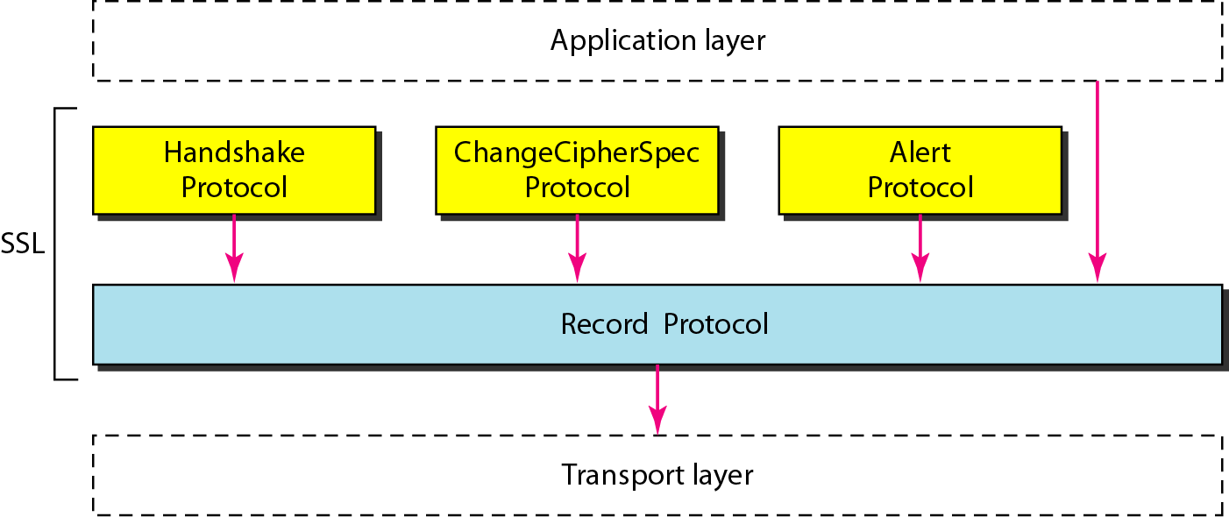
Figure 32.16 Four SSL protocols

Slide 30
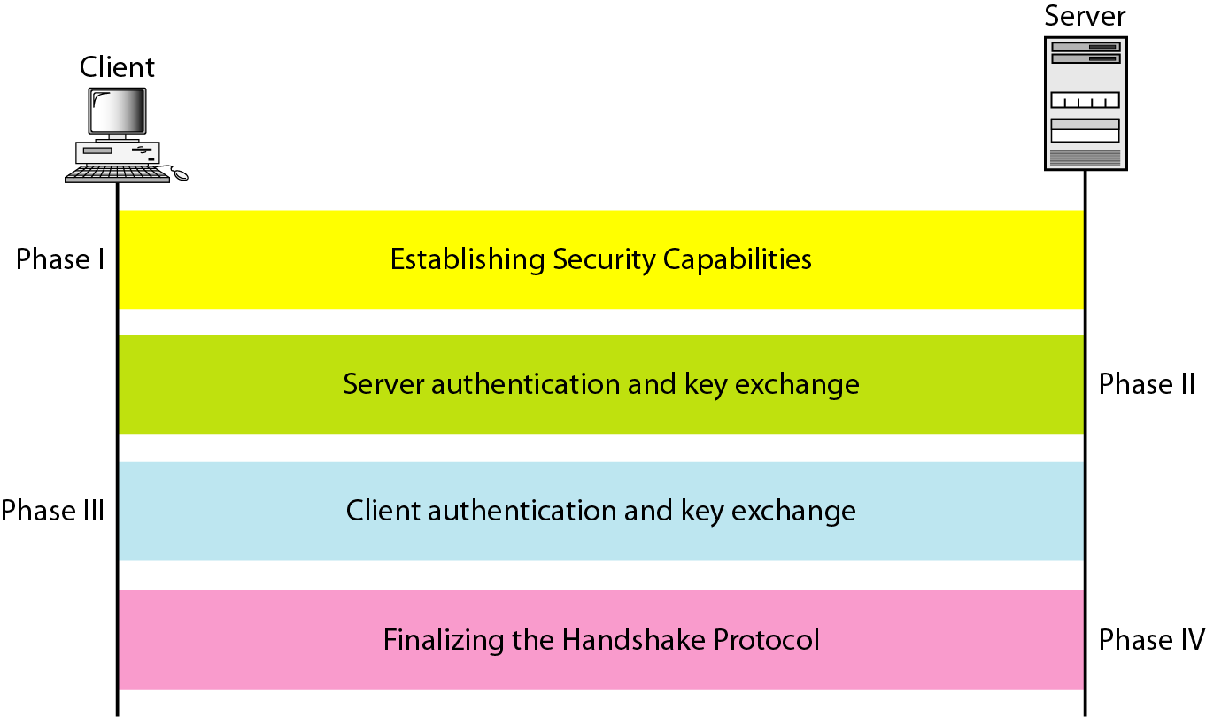
Figure 32.17 Handshake Protocol

Slide 31
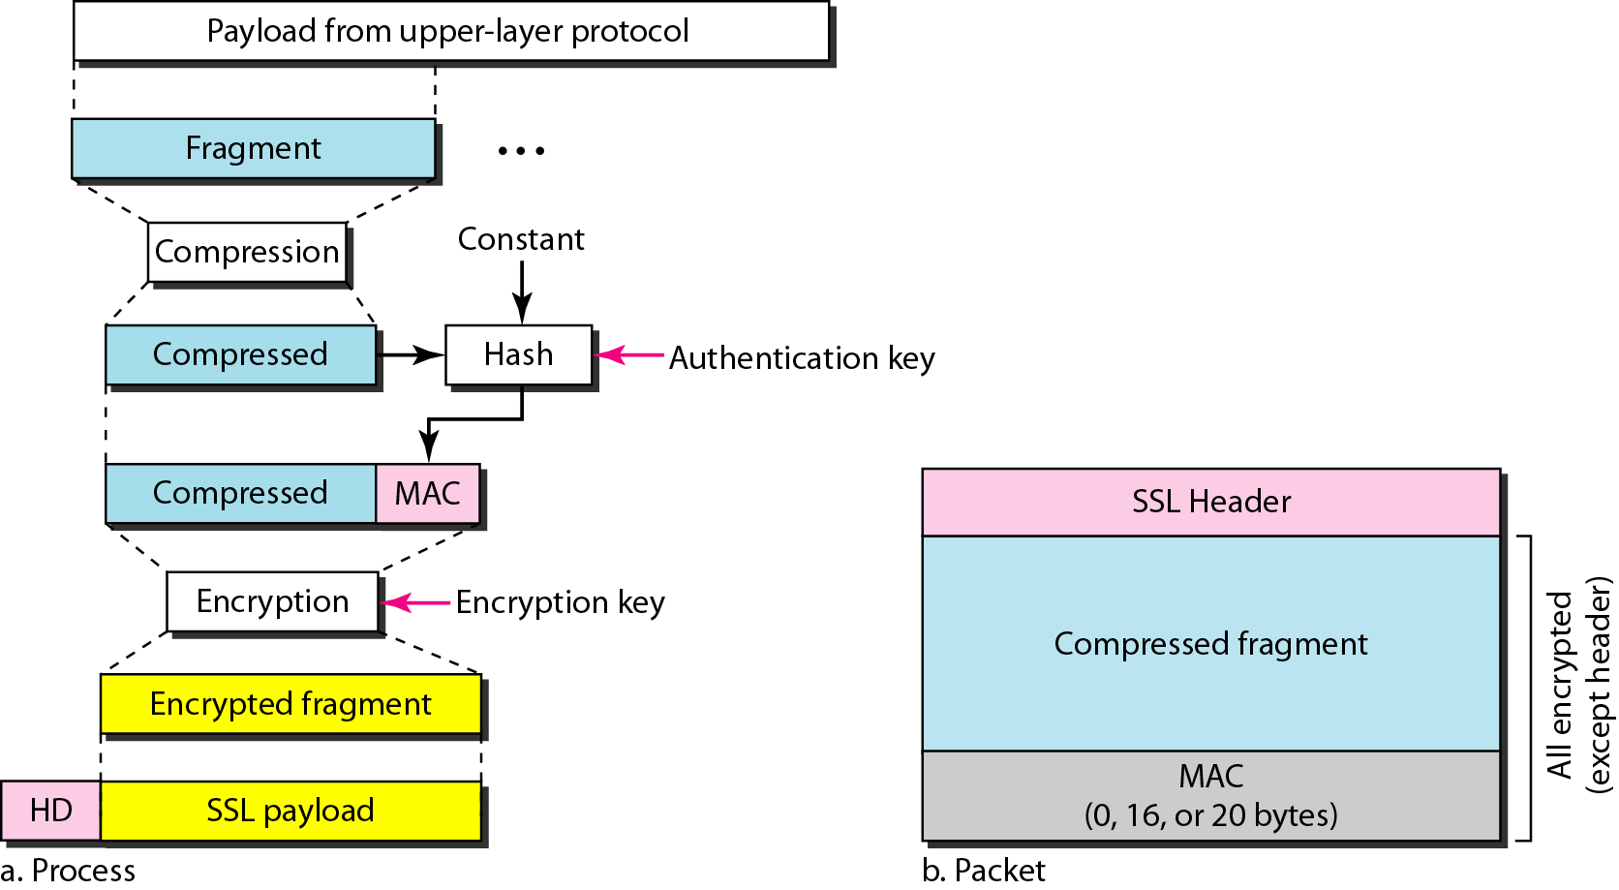
Figure 32.18 Processing done by the Record Protocol

Slide 32
32-3 PGP
One of the protocols to provide security at the application layer is Pretty Good Privacy (PGP). PGP is designed to create authenticated and confidential
e-mails.
Topics discussed in this section:
Security Parameters
Services
A Scenario
PGP Algorithms
Key Rings
PGP Certificates

Slide 33
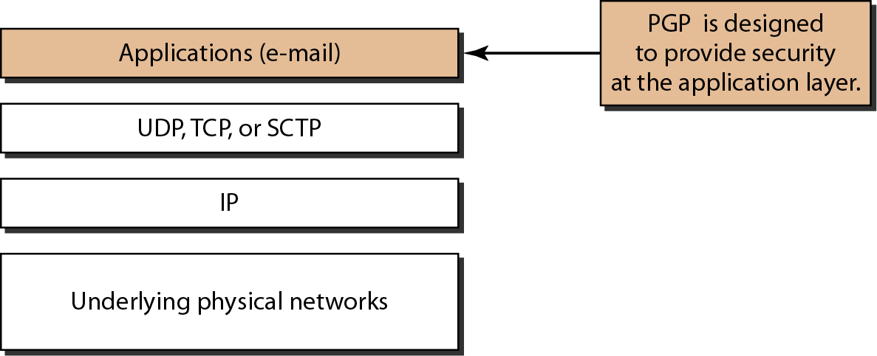
Figure 32.19 Position of PGP in the TCP/IP protocol suite

Slide 34
Note
In PGP, the sender of the message needs to include the identifiers of the
algorithms used in the message as well as the values of the keys.

Slide 35
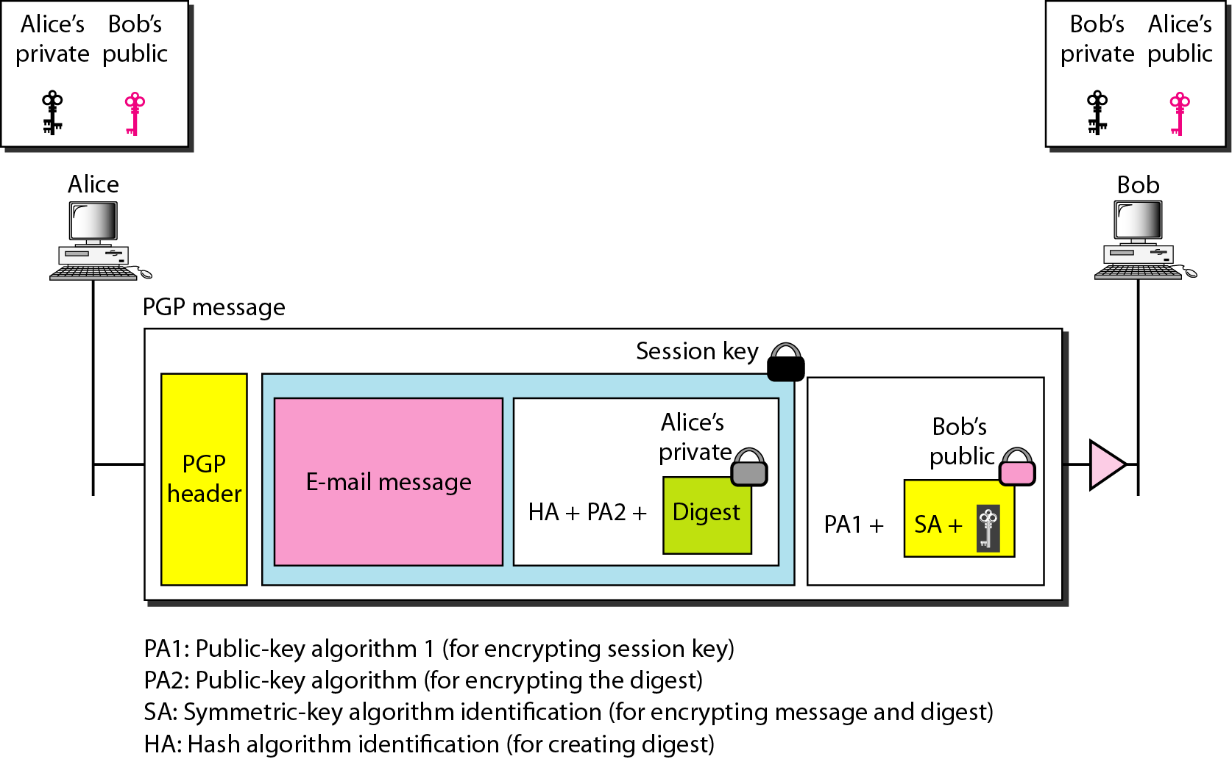
Figure 32.20 A scenario in which an e-mail message is
authenticated and encrypted

Slide 36
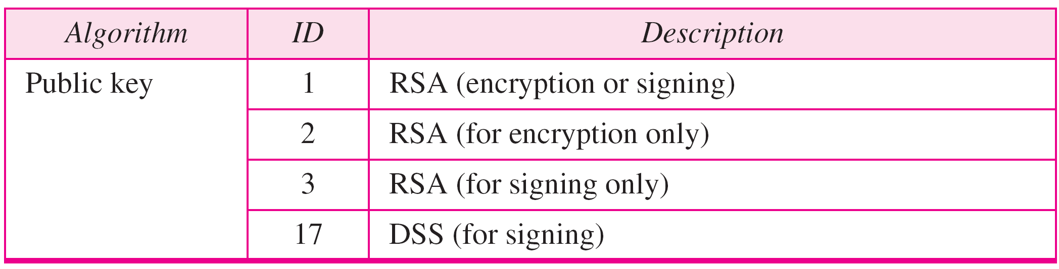
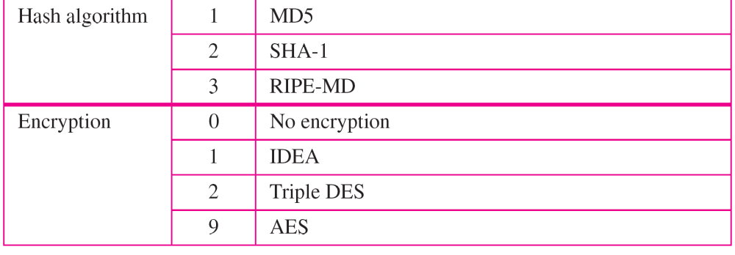
Table 32.4 PGP Algorithms

Slide 37
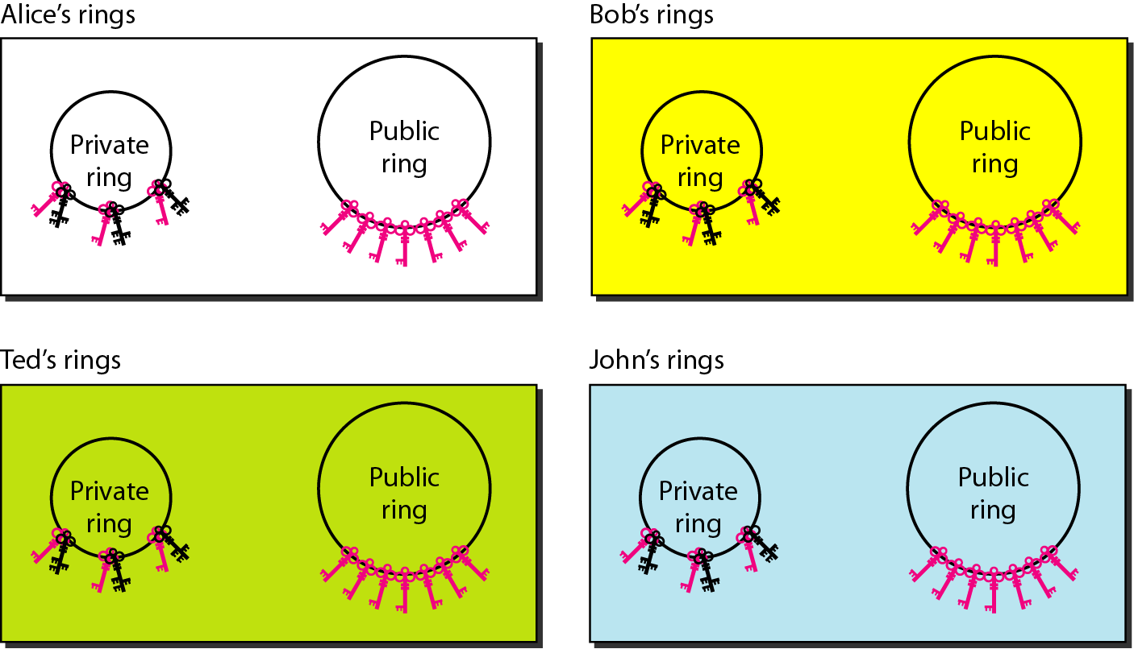
Figure 32.21 Rings

Slide 38
Note
In PGP, there can be multiple paths from fully or partially trusted authorities to any subject.

Slide 39
32-4 FIREWALLS
All previous security measures cannot prevent Eve from sending a harmful message to a system. To control access to a system, we need firewalls. A firewall is a device installed between the internal network of an organization and the rest of the Internet. It is designed to forward some packets and filter (not forward) others.
Topics discussed in this section:
Packet-Filter Firewall
Proxy Firewall

Slide 40
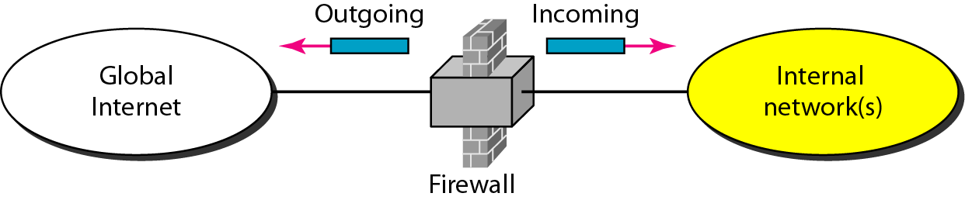
Figure 32.22 Firewall

Slide 41
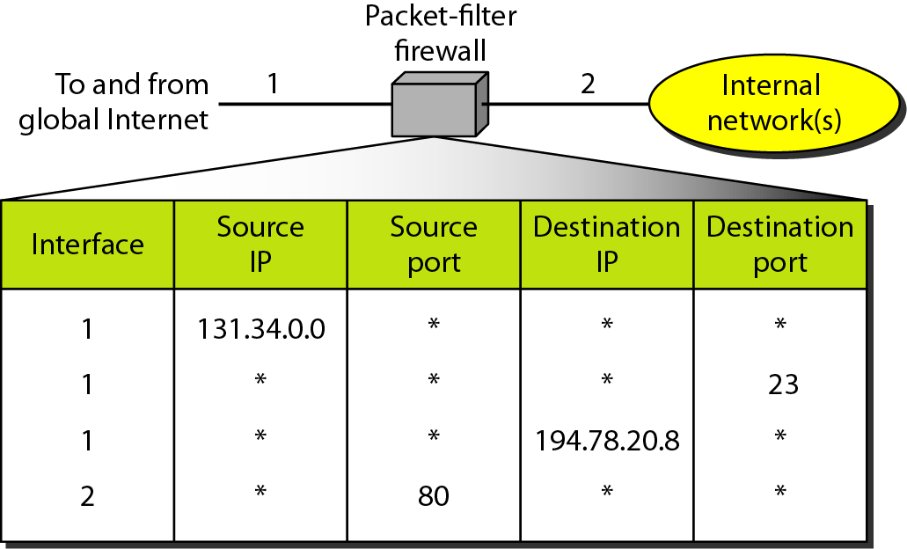
Figure 32.23 Packet-filter firewall

Slide 42
Note
A packet-filter firewall filters at the network or transport layer.

Slide 43
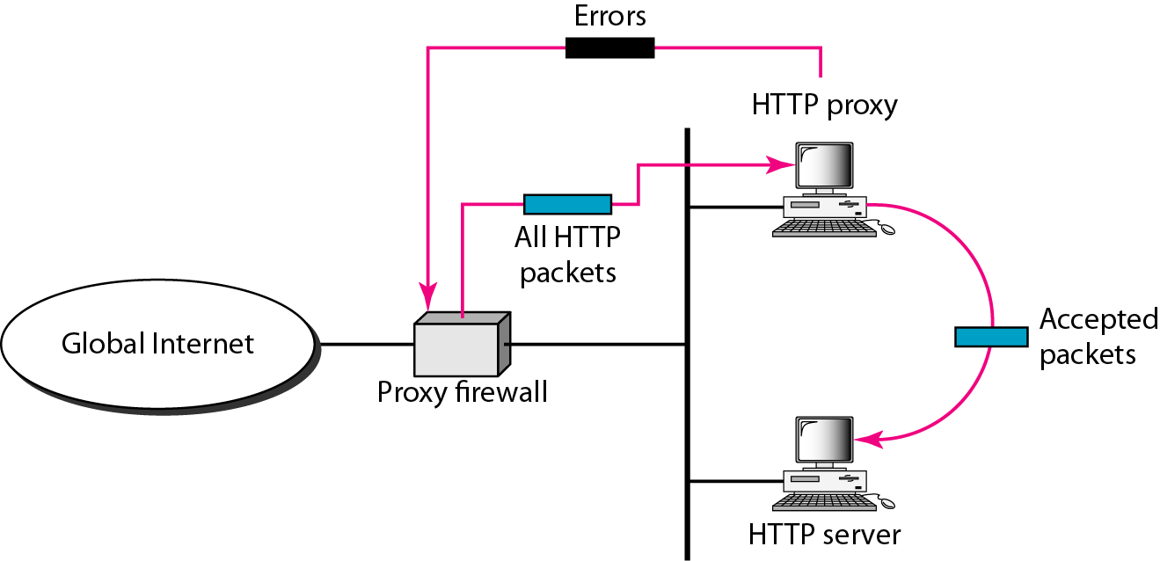
Figure 32.24 Proxy firewall

Slide 44
Note
A proxy firewall filters at the
application layer.

